Slide 1
Speech Emotion Recognition
Pattern Recognition & Machine Learning Laboratory
Ha-Na Jo
Oct. 04, 2022

Slide 2
Project Description
Goal
Attempting to recognize human emotion and affective states from speech
This is capitalizing on the fact that voice often reflects underlying emotion through tone and pitch.
This is also the phenomenon that animals like dogs and horses employ to be able to understand human emotion.
Datasets used in this project
Crowd-sourced Emotional Multimodal Actors Dataset (Crema-D)
7,442 original clips from 91 actors
Six different emotions (anger, disgust, fear, happy, neutral, and sad)
Ryerson Audio-Visual Database of Emotional Speech and Song (Ravdess)
1,440 audio-only files from 24 actors
Seven different emotions (calm, happy, sad, angry, fear, surprise, and disgust)
Surrey Audio-Visual Expressed Emotion (Savee)
480 utterances from four speaker
Seven different emotions (anger, disgust, fear, happy, sad, surprise, and neutral)
Toronto emotional speech set (Tess)
2800 data points in total
Seven different emotions (anger, disgust, fear, happy, surprise, sad, and neutral)

Slide 3
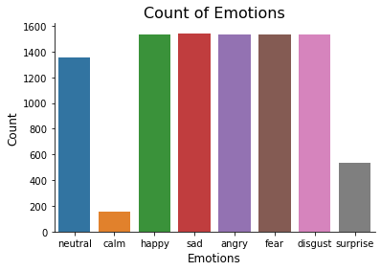
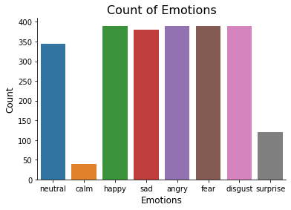
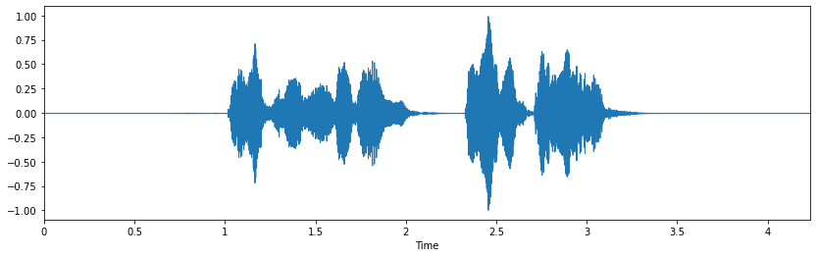

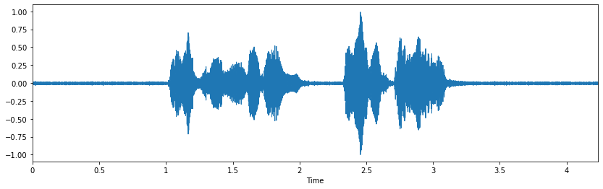
Preprocessing
Data information
Total 12,162 audio files
80% for train and 20% for test set
Data preprocessing
Data labeling
For eight different emotions
Neutral, calm, happy, sad, angry, fear, disgust, and surprise
Data augmentation
Noise injection (prevention overfitting)
Add uniform distribution noise in the audio
Count of emotions (train set)
Sample of
origin audio
Sample of
noise audio
Count of emotions (test set)

Slide 4
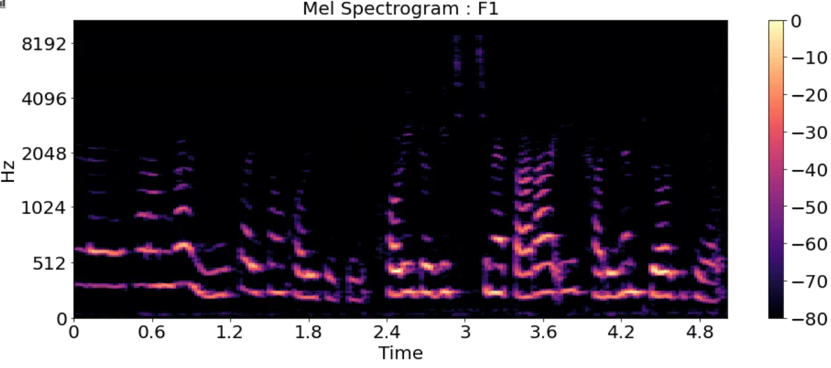
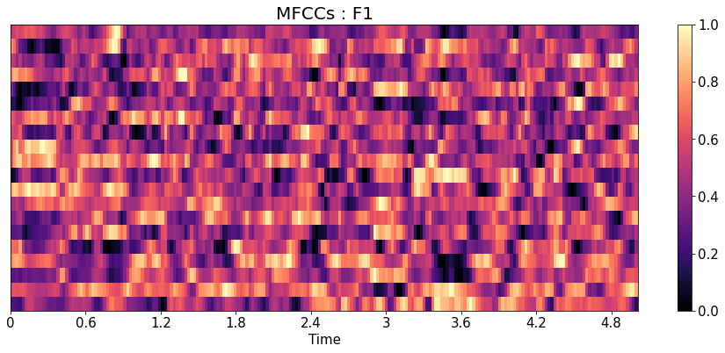
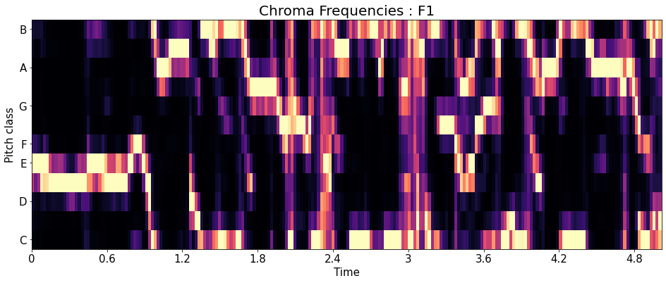
Preprocessing (Cont.)
Speed modifying and pitch changing
Feature extraction
Zero crossing rate
The rate of sign-changes of the signal during the duration of a particular frame
Mel spectrogram
Analyzing audio with time-varying frequency characteristics
Mel-frequency cepstral coefficients (MFCC)
The inverse Fourier transform of the logarithmic value of the spectral signal
Chroma short-time Fourier transform (STFT)
The features of chroma contain harmonies or pitches information
Root mean square value
Preprocessing results
29,154 data for a train set and 7,332 data for a test set (tripled from original data)
By data augmentation
162 features per 1 data are extracted
Sample of pitch changed audio
Example of Mel spectrogram
Example of MFCC
Example of chroma

Slide 5
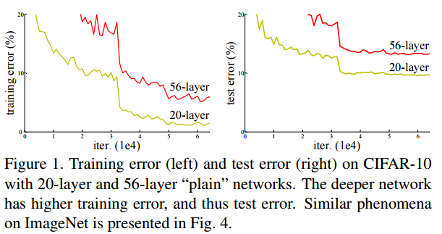
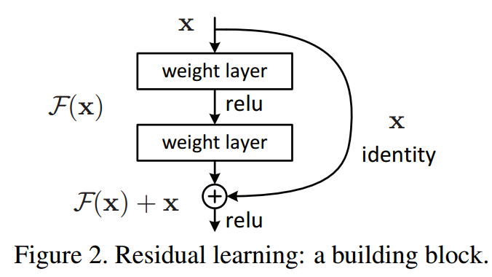
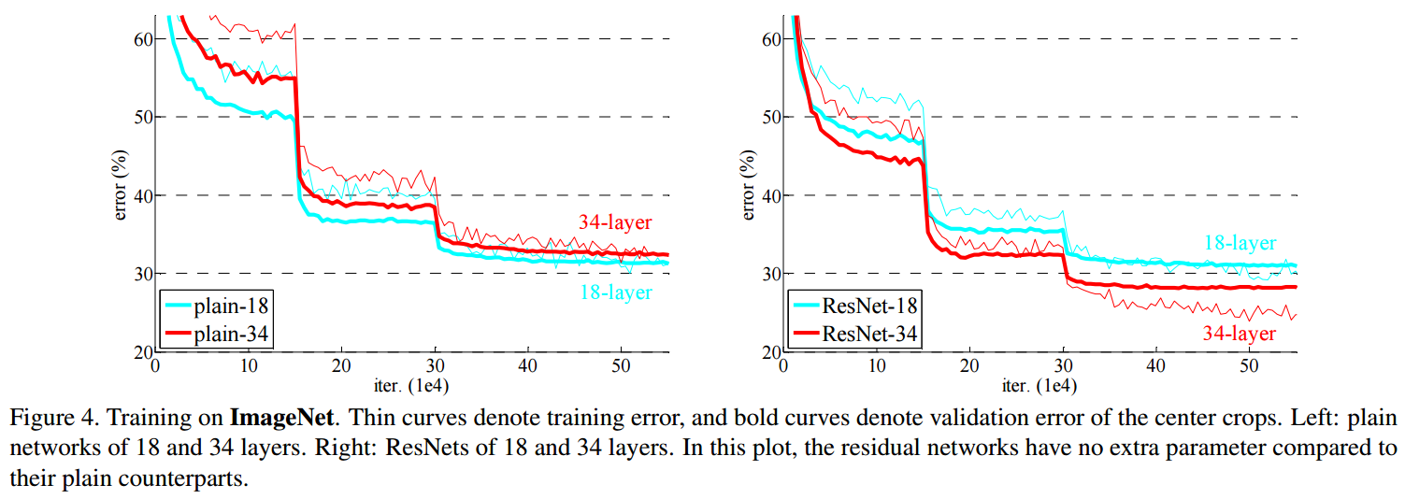
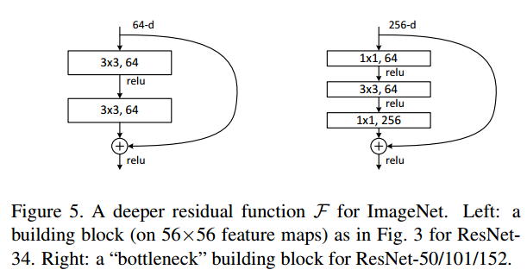
Baseline Model
Resnet
Goal
Prevented gradient vanishing and exploding problems in deep neural networks
Methods
Skip connection in the residual network
Solved gradient vanishing problem
Bottleneck design
Solved time-consuming problem
Result
A lower error rate in deep neural networks (34-layer) compared to lighter neural networks (18-layer)
K. He et al., "Deep Residual Learning for Image Recognition," CVPR, 2015.

Slide 6
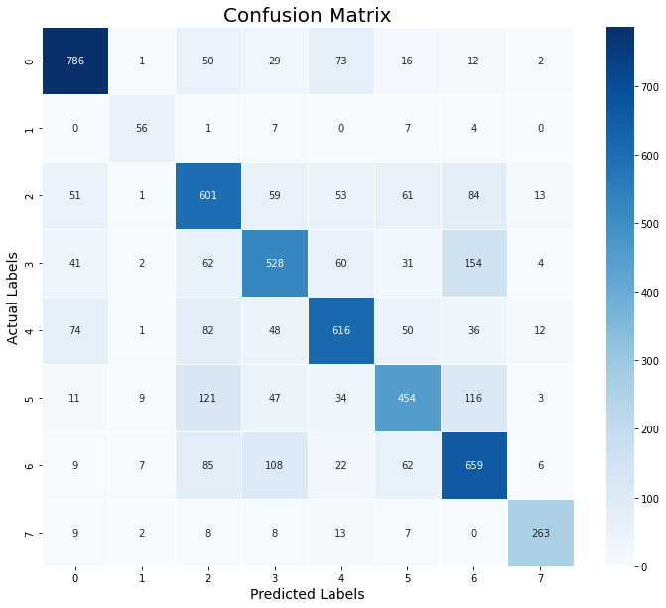
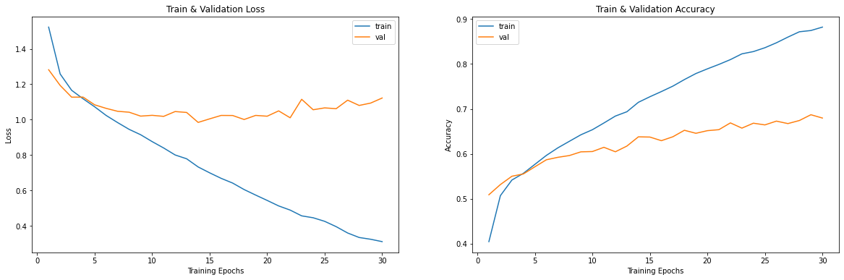
Baseline Model (Cont.)
Training data
Features data after data augmentation
29,154(80 % of data) for train and 7,332(20 % of data) for test
23,323(80 % of train set) for train and 5,831(20 % of train set) for validation
Training setting
Resnet 34-layer, basic block
Batch size: 100, epoch: 30, learning rate: 0.0001
Result
88.21 % accuracy for the training set
67.96 % accuracy for the validation set
Loss of train and validation
Accuracy of train and validation
Confusion matrix of validation

Slide 7
Additional Information
Git hub
https://github.com/HanaJo-ku/NNAP
Data part
Feature data with label file for a train (.csv)
You should train using this data, NOT RAW DATA
Feature data without label file for a test (.csv)
Run part
Preprocessing and feature extraction code (.ipynb)
Training and validation run code (.ipynb)
Reference
Train set, test set raw files (google drive link)
E-mail
hn_jo@korea.ac.kr

